Slide 1
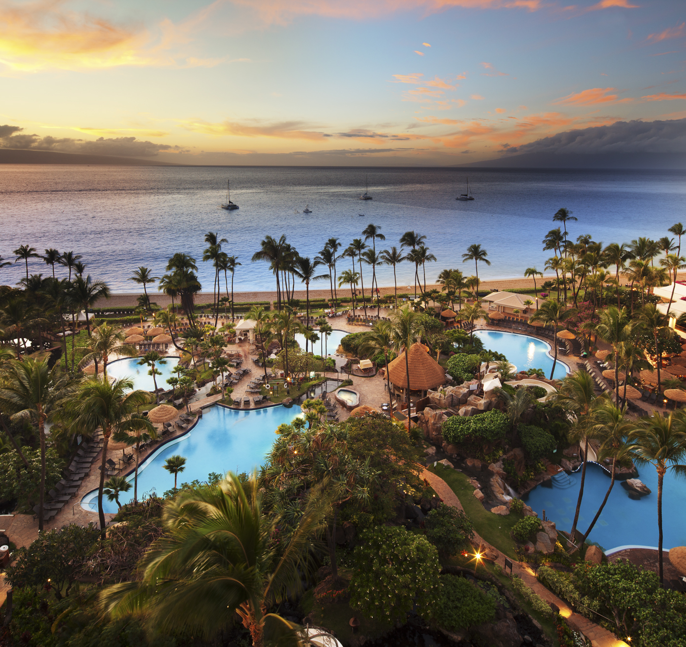
CUSTOMER BEHAVIOR PREDICTION USING MLR AND KNN REGRESSION
HOTEL - LISBON, PORTUGAL
TRANG NGUYEN
1

Slide 2
AGENDA
01
03
02
04
1. INTRODUCTION
2. OBJECTIVE
3. APPROACH
4. RESULTS
5. RECOMMENDATIONS
2

Slide 3
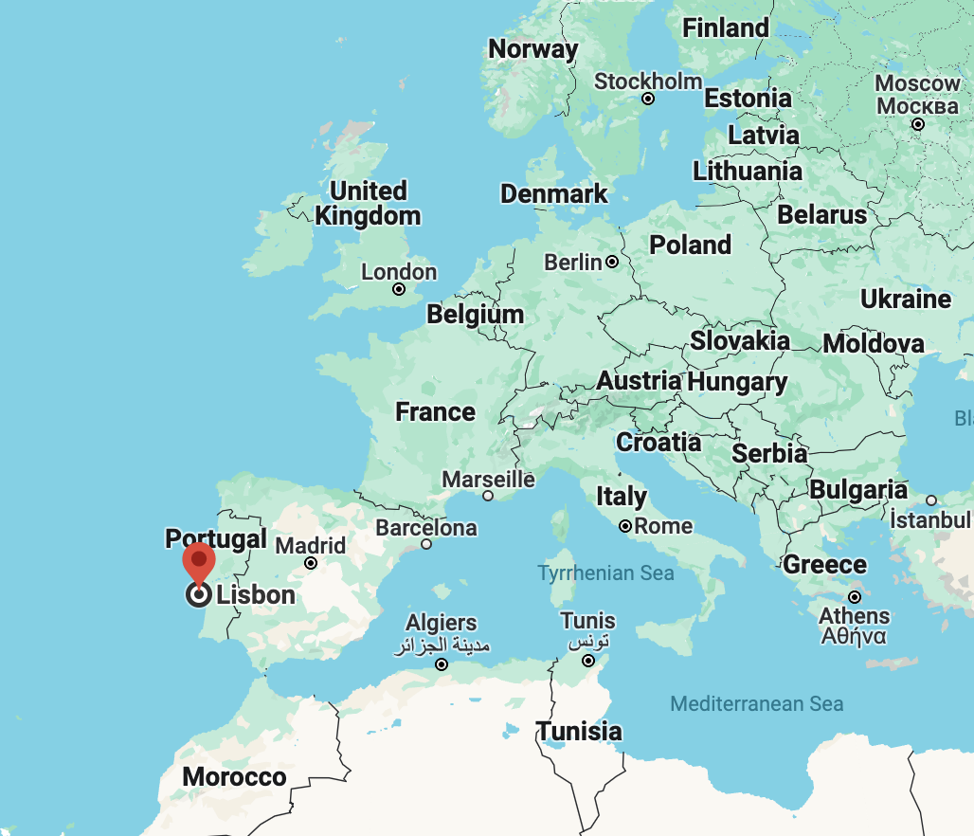
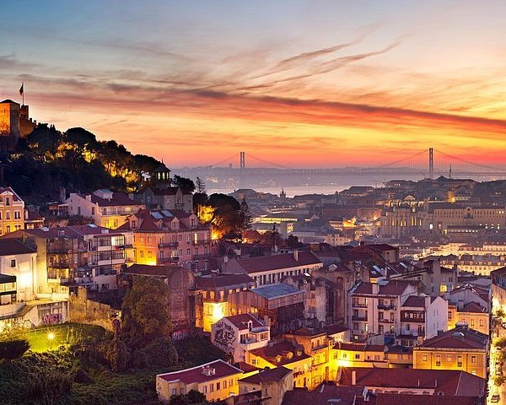
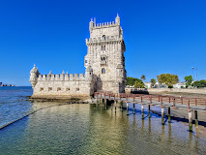
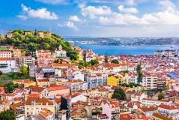

INTRODUCTION
Lisbon, Portugal: one of the most popular tourist destinations in Europe
INTRODUCTION
OBJECTIVE
RECOMMENDATIONS
RESULTS
APPROACH
3

Slide 4

OBJECTIVE
The tourism industry is one of the most significant contributors to the economic growth of Portugal. Each year, it contributes the largest share of revenues to Portugal's economy compared to other regions in the country
The tourism industry, particularly the hotel sector in Lisbon, Portugal, is a highly competitive market.
Which factors contributed the most to the hotel's revenue increase?
Does customer behavior impact the hotel's increasing revenue?
Which distribution channel and market segment play the most significant roles in the hotel's revenue growth?
OBJECTIVE
RESULTS AND RECOMMENDATIONS
DATA ANALYSIS
INTRODUCTION
4

Slide 5



DATA
Processed Data
46,188 observations with 34 variables
Removed Variables:
NameHash
DocIDHash
Additional Variables:
TotalRevenue
RatePerNight
AgeGroups
MarketSegmentCombined
Data Collection
Data Source: Hotel dataset in Lisbon, Portugal 2015 – 2018
Original Data: 80,000 customers and 32 variables
Data Cleaning
No duplicate rows
3598 missing values - Age
18,249 typo errors (-1) - DaysSinceLastStay & DaysSinceFirstStay
8 negative values in AverageLeadTime
Outliers identified in Age, AverageLeadTime, LodgingRevenue, OtherRevenue, PersonsNights, and RoomNights were removed.
INTRODUCTION
APPROACH
OBJECTIVE
RECOMMENDATIONS
RESULTS
5

Slide 6
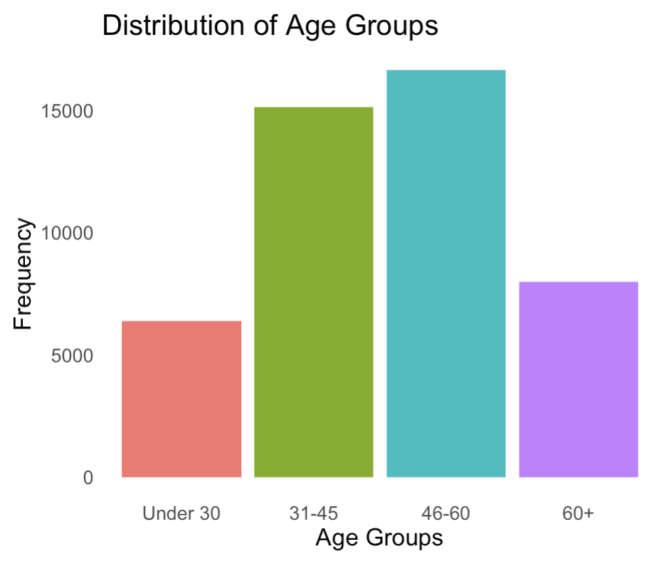
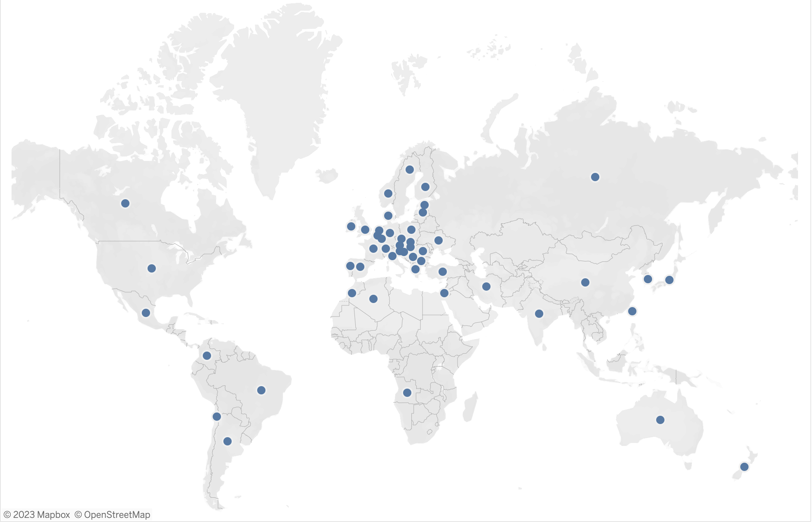
INSIGHTS
Geographically Map Hotel Customers from 50 Countries
INTRODUCTION
APPROACH
OBJECTIVE
RECOMMENDATIONS
RESULTS
6

Slide 7
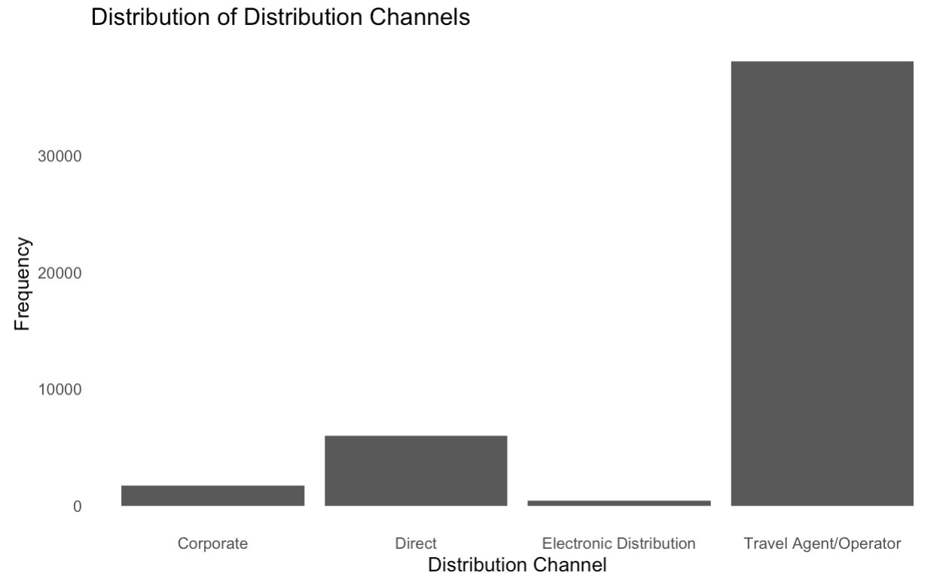
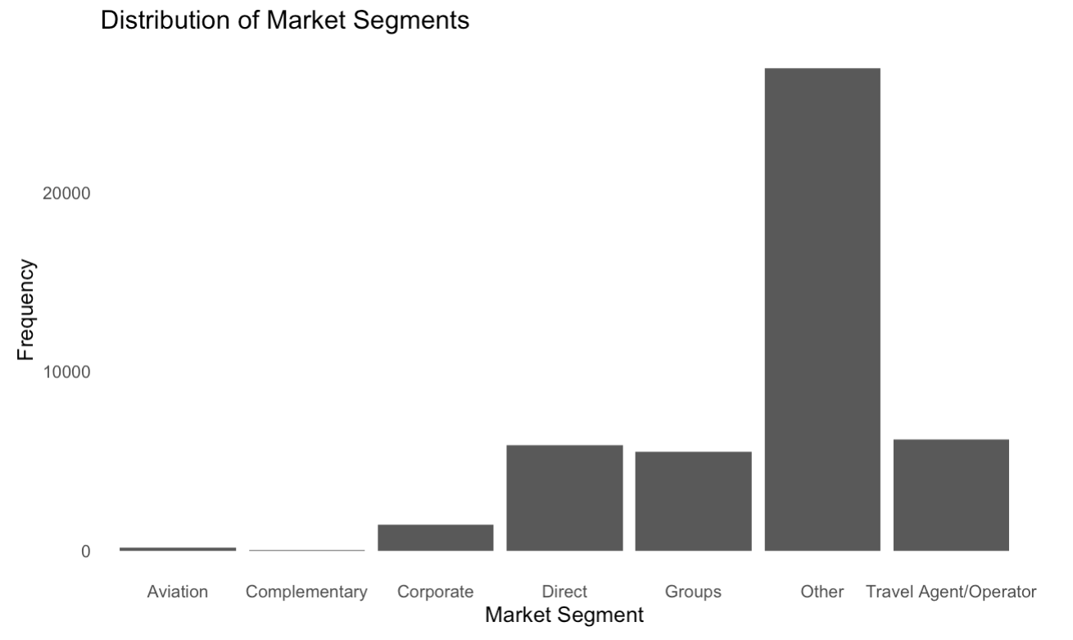
INSIGHTS
INTRODUCTION
APPROACH
OBJECTIVE
RECOMMENDATIONS
RESULTS
7
Notes:
There are 7 different market segment of customers of the hotel

Slide 8
INSIGHTS
Customer Room Preference | Don’t-Request | Do-Request
SRAccessibleRoom | 100.0 | 0.03208
SRAwayFromElevator | 99.6 | 0.35506
SRBathtub | 99.8 | 0.23956
SRCrib | 99.1 | 0.91545
SRHighFloor | 95.5 | 4.49169
SRKingSizeBed | 64.9 | 35.10363
SRLowFloor | 99.9 | 0.12192
SRMediumFloor | 99.9 | 0.07914
SRNearElevator | 100.0 | 0.04064
SRNoAlcoholInMiniBar | 100.0 | 0.00428
SRQuietRoom | 91.2 | 8.77163
SRShower | 99.8 | 0.17111
SRTwinBed | 87.3 | 12.69223
INTRODUCTION
APPROACH
OBJECTIVE
RECOMMENDATIONS
RESULTS
8
Notes:
the table provides insights into the distribution of customer preferences for different room features

Slide 9
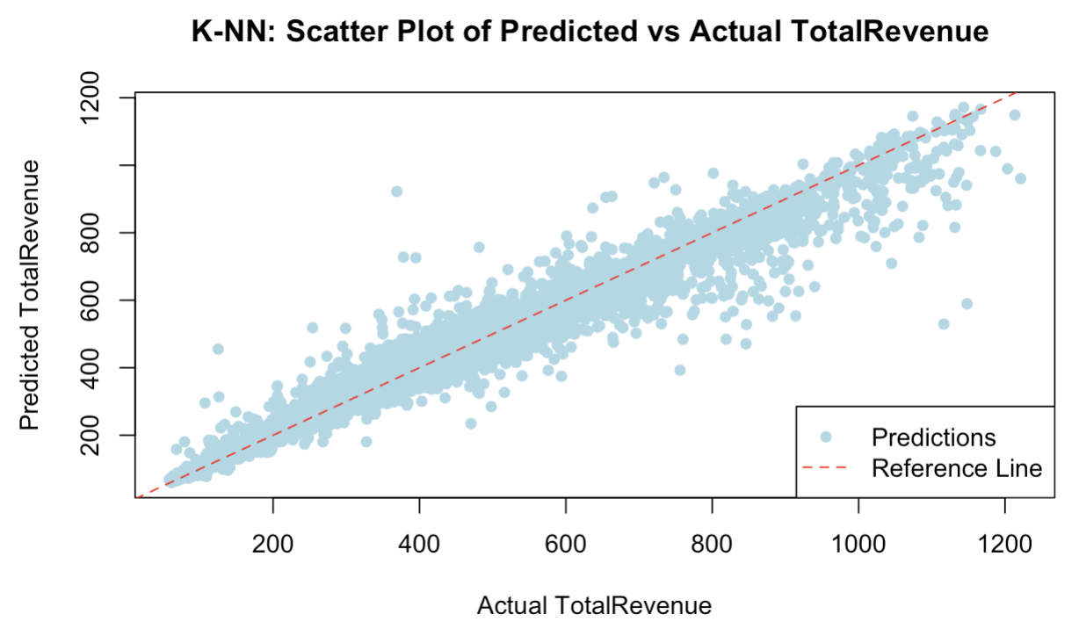
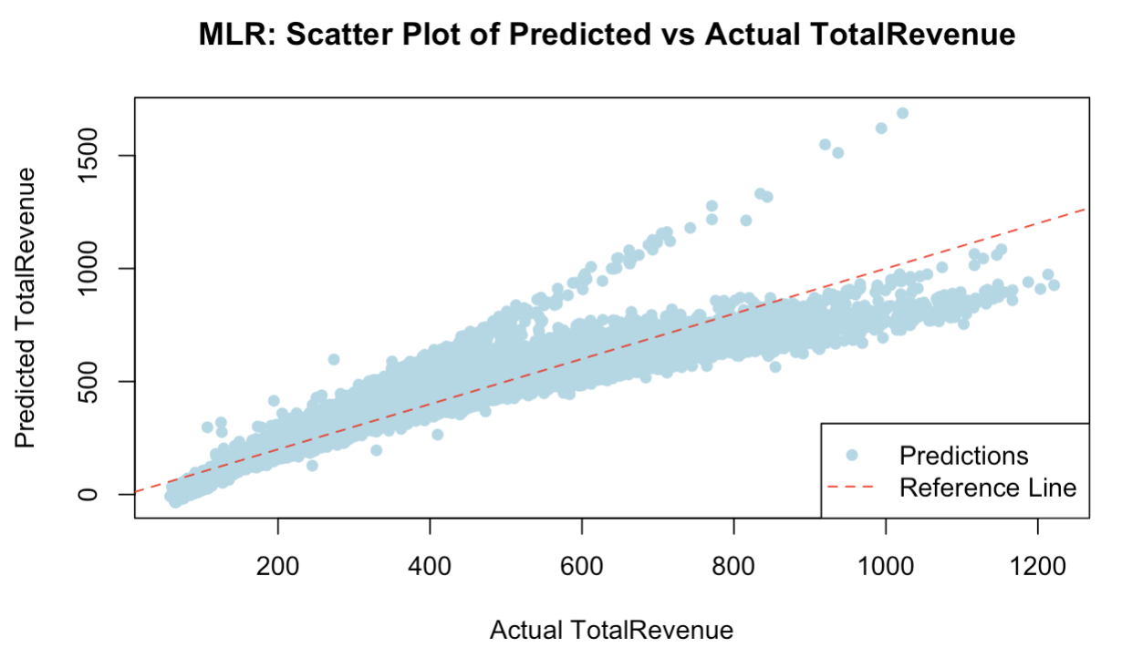
MODEL PERFORMANCE: Multiple Linear Regression (MLR) and K-NN Regression
Evaluation | Multiple Linear Regression (MLR | K-NN Regression
ME | 0.257 | -2.45
RMSE | 64.2 | 30.8
MAE | 41.3 | 14.3
MPE | 0.0297 | -0.0826
MAPE | 12.4 | 3.57
K-NN Regression demonstrates better performance than MLR with lower errors across different metrics.
The model delivers more accurate predictions on the dataset.
9

Slide 10


K-Means Clustering Analysis
Customer Preferences
AverageLeadTime
PersonsNights
RoomNights
RatePerNight
OtherRevenue
Food, Beverage, Spa, and Other Expenses
10

Slide 11
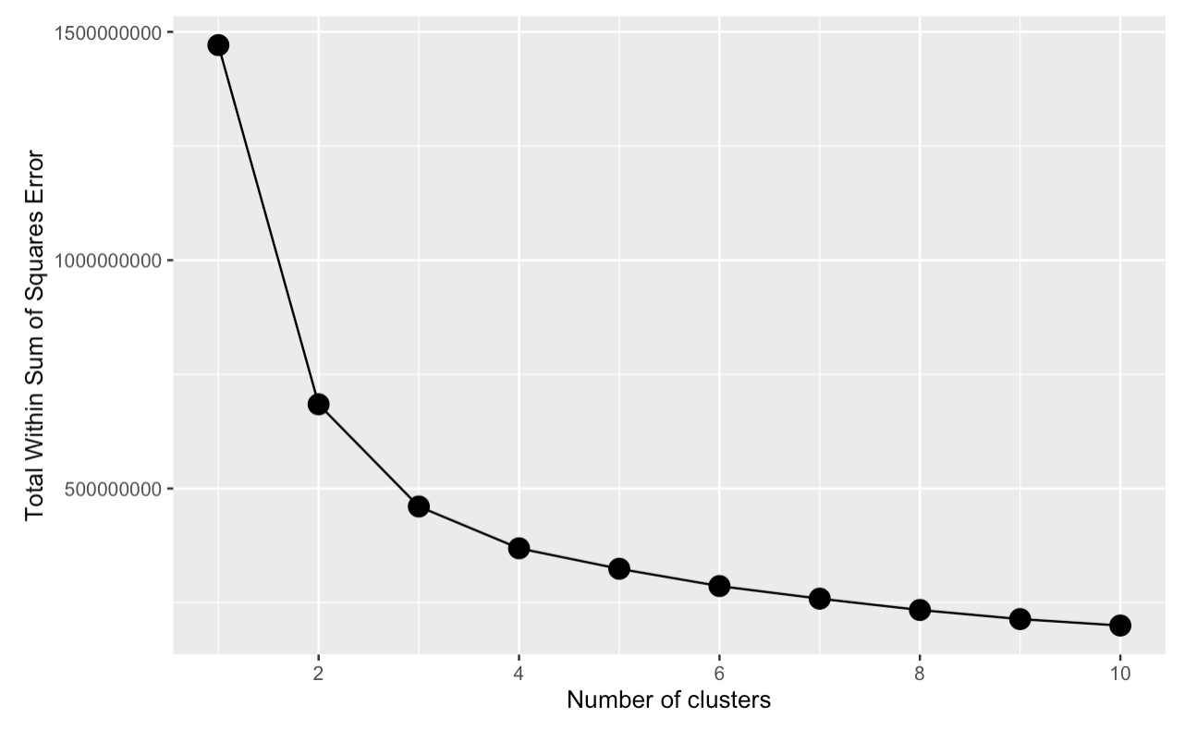
K-Means Clustering Analysis
 | AverageLeadTime | PersonsNights | RoomNights | RatePerNight | OtherRevenue | TotalSpending
1 | 83 | 7 | 3 | 119 | 73.7 | 431
2 | 59 | 3 | 2 | 102 | 30.4 | 200
3 | 75 | 8 | 4 | 191 | 102.0 | 741
Elbow Method Determines Optimal k Value
Tourists traveling together in large groups, who stay for an extended period at the hotel, prefer to book in advance, typically a few months before arrival, as they can get a lower RatePerNight
11
Notes:
To understand customer behavior, I aply K-Means Clustering Analysis to cluster data in similarities based on customer preferences and customer spending behavior.

Slide 12
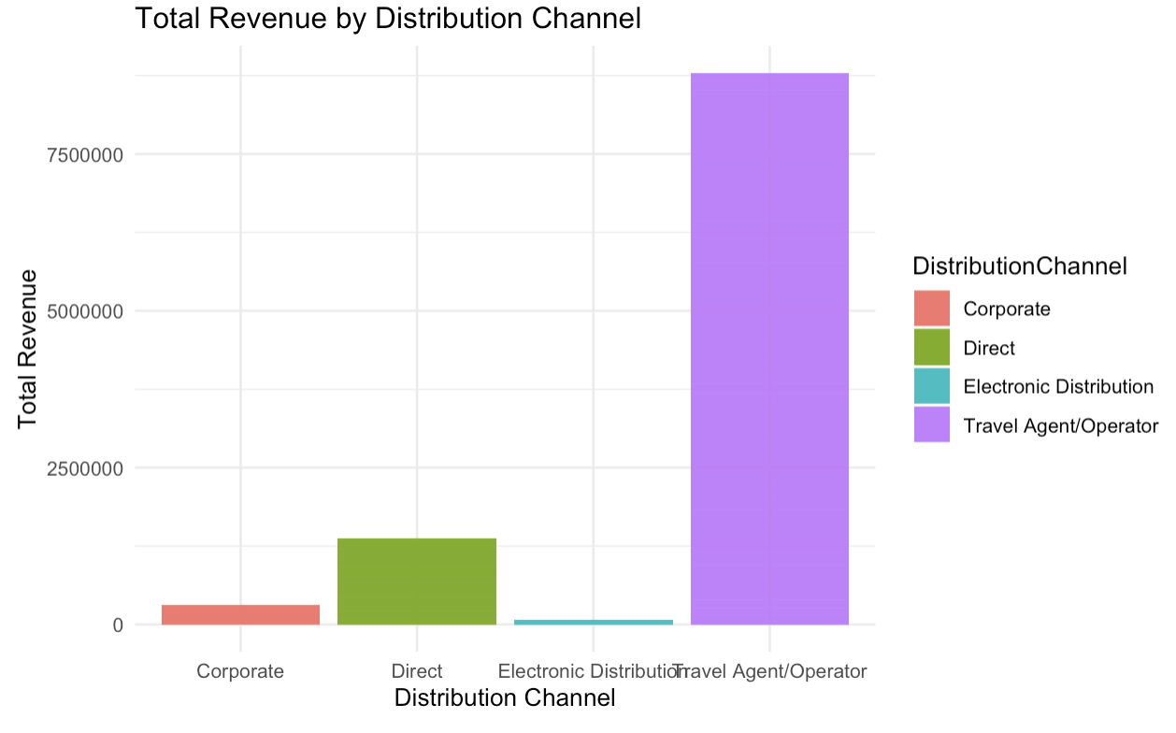
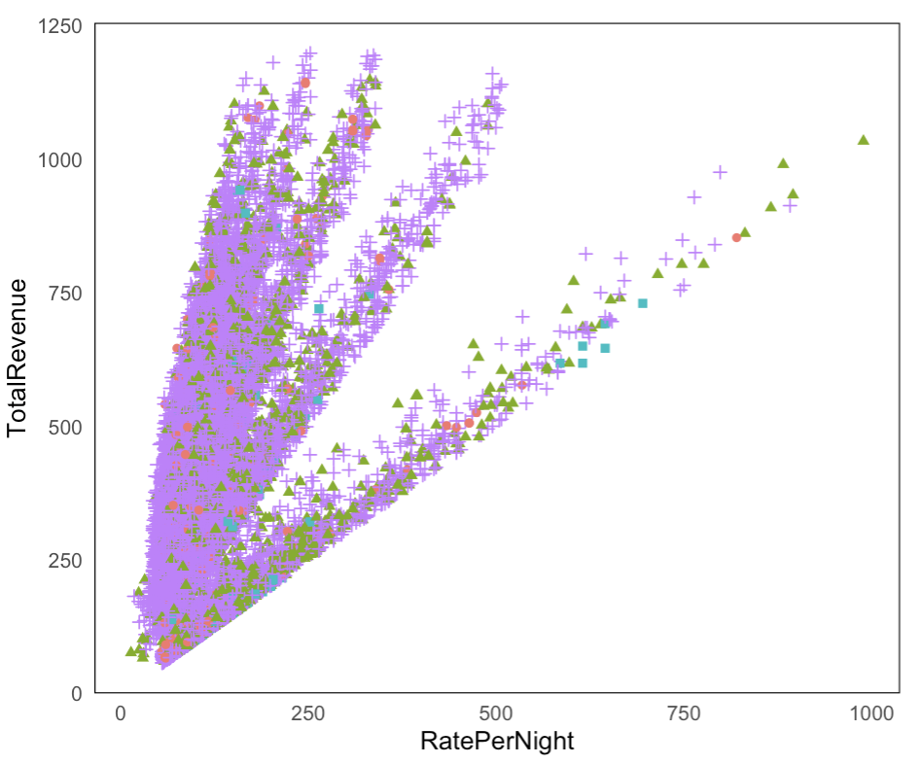
K-Means Clustering Analysis
Distribution Channel | Average Revenue (in Euros)
TravelAgent/Operator | 1,071,712
Direct | 175,869
Corporate | 35,242
Electric | 9,937
Most tourists prefer booking through a Travel Agent/Operator.
Travel Agent/Operator contributes the highest total revenue for the hotel.
12

Slide 13
Implement K-NN regression model to predict price
 | AverageLeadTime | PersonsNight | RoomNight | OtherRevenue | MarketSegment | DistributionChannel | TotalRevenue
Customer A | 30 | 1 | 1 | 40 | Groups | Electronic | 138
Customer B | 30 | 1 | 1 | 40 | Other_-Complementary | Travel Agent/Operator | 130
 | Corporate | Direct | Electric | Travel Agent/Operator
Aviation | 156 | 0 | 0 | 4
Corporate | 1133 | 31 | 1 | 298
Direct | 7 | 5914 | 2 | 75
Groups | 318 | 82 | 1 | 5152
Other-Complementary | 25 | 58 | 430 | 26799
Travel Agent/Operator | 82 | 12 | 4 | 6169
INTRODUCTION
APPROACH
OBJECTIVE
RECOMMENDATIONS
RESULTS
13
Notes:
Travel Agent/Operator: customers or clients who make bookings, reservations, or transactions through a travel agent or operator.

Slide 14
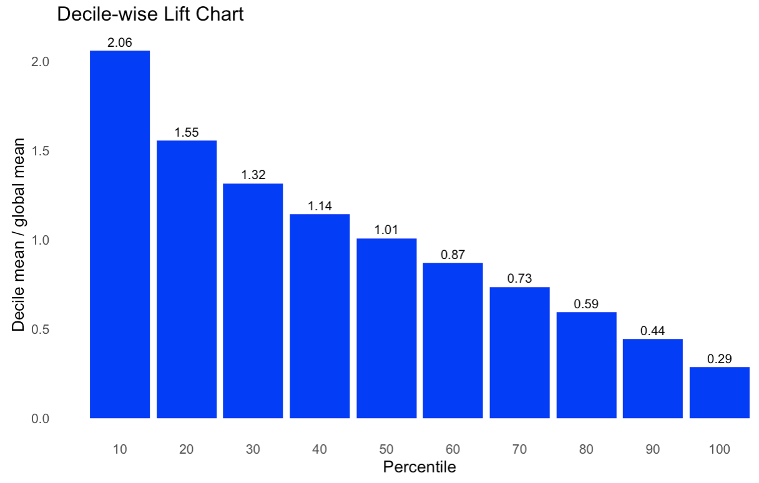
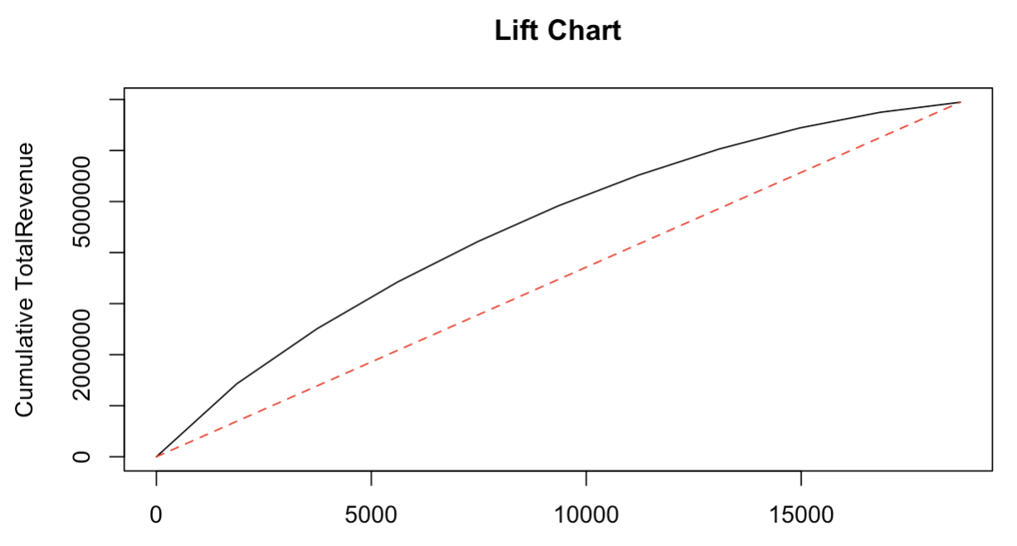
MODEL PREDICTIONS
The revenue of a random 1,870 customers is 694,569 (in Euros). The revenue of the top 10% of customers (1,870 customers) is predicted to be a total of 1,486,464(in Euros).
INTRODUCTION
APPROACH
OBJECTIVE
RECOMMENDATIONS
RESULTS
14

Slide 15
RECOMMENDATIONS
Promotion of Cheaper Rates: The hotel should consider implementing strategies to attract customers seeking cheaper rates: special promotions, discounts, or package deals
Building Strong Relationships with Travel Agents/Operators: offering exclusive deals or partnerships to encourage more bookings through this channel
Targeting Complementary Market Segment
Customer Loyalty Programs: encourage customers to return, offering rewards, discounts, or exclusive packages to loyal customers
INTRODUCTION
APPROACH
OBJECTIVE
RECOMMENDATIONS
RESULTS
15

Slide 16
REFERENCES
Froyd, J. N. (2023, July 16). Tourism in Lisbon Reached a Record Revenue Per Room. Tourism Review. Retrieved October 29, 2023, from https://www.tourism-review.com/tourism-in-lisbon-reported-maximum-revenues-news13418.
16

Slide 17
THANK YOU

Slide 18
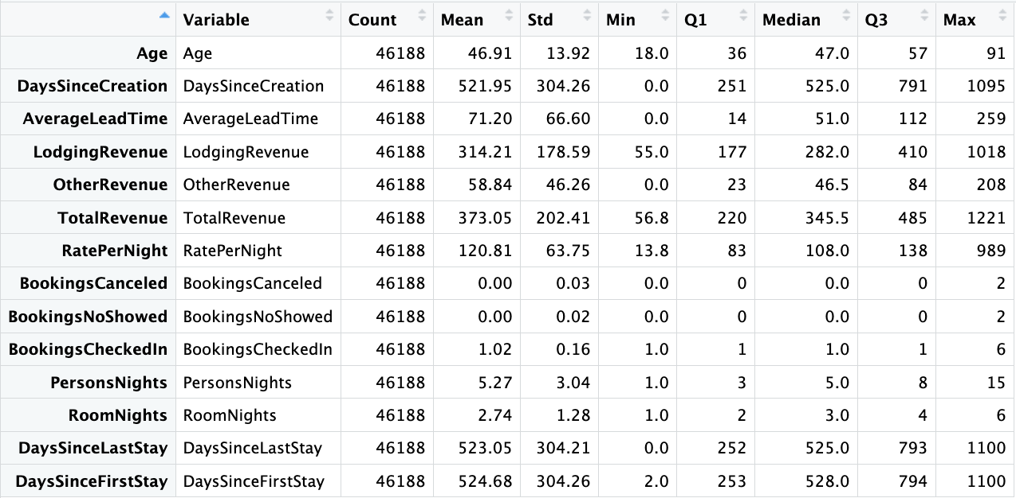
APPENDIX
Data Summary Statistics
3 Characteristics Of Customers:
Nationality
NameHash
DocIDHash
AgeGroups
CustomerTypes
2 Characteristics Of Bookings:
DistributionChannel
MarketSegment
13 Characteristics Of Room Customer Preferences

Slide 19
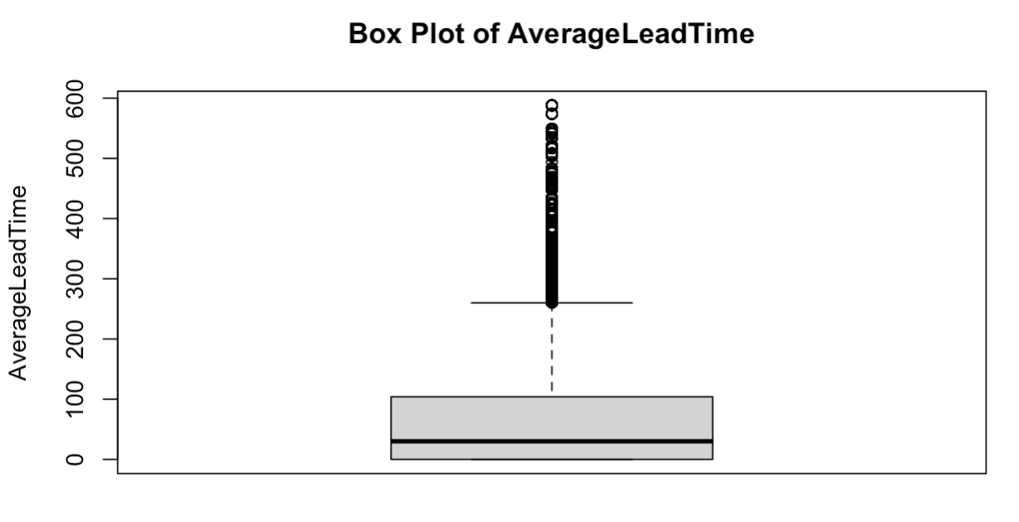
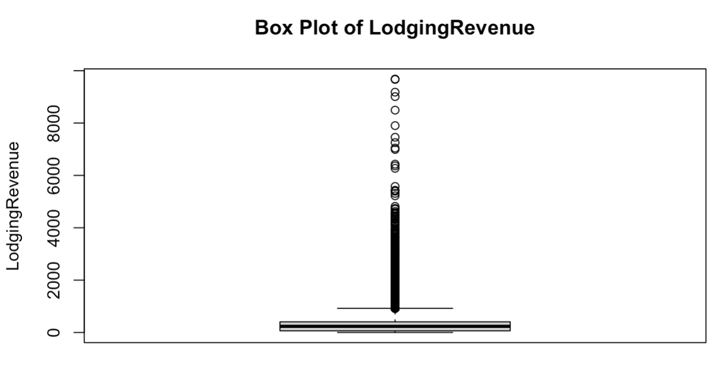
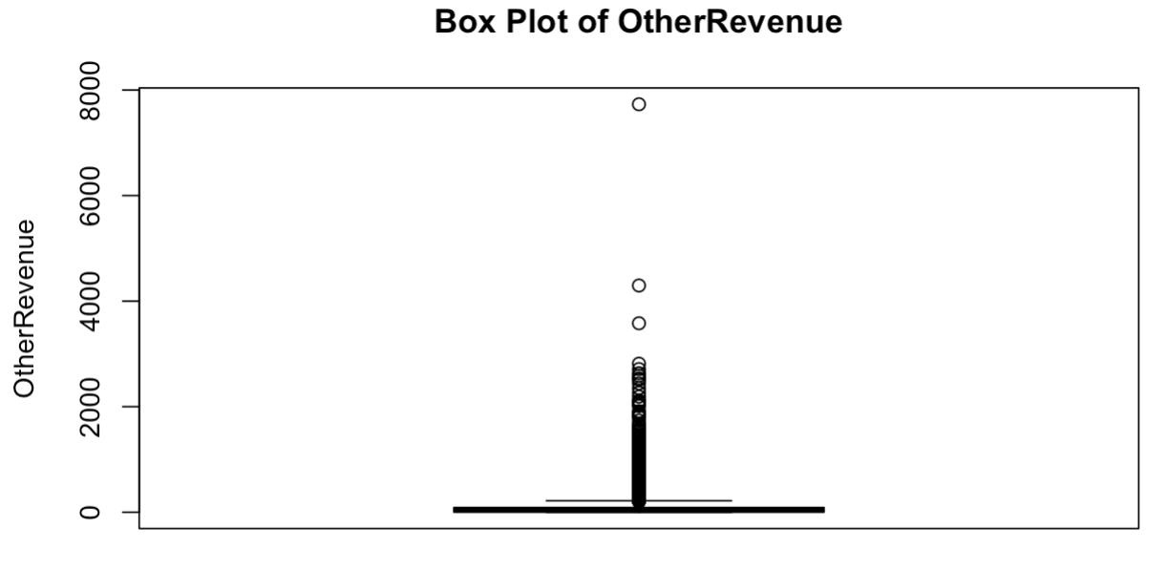
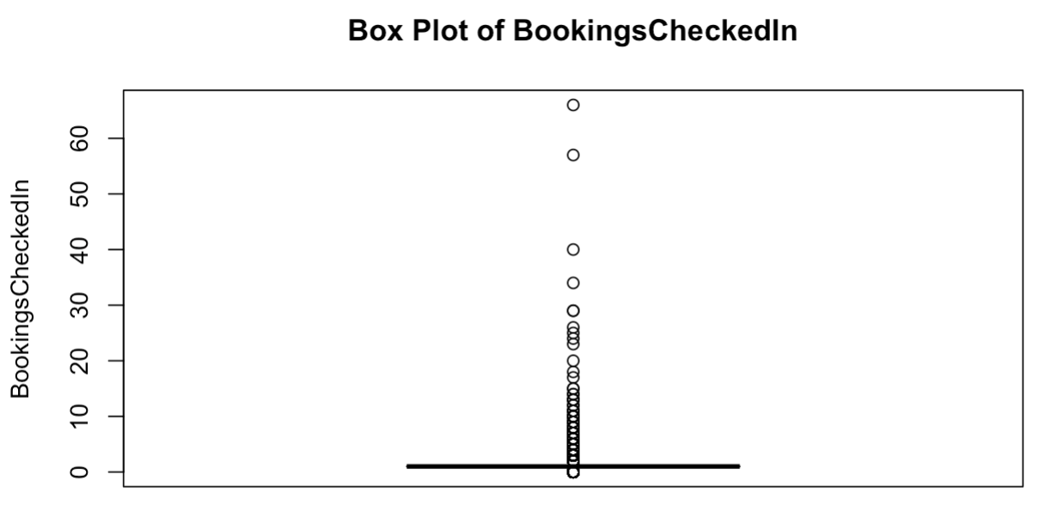
APPENDIX

Slide 20
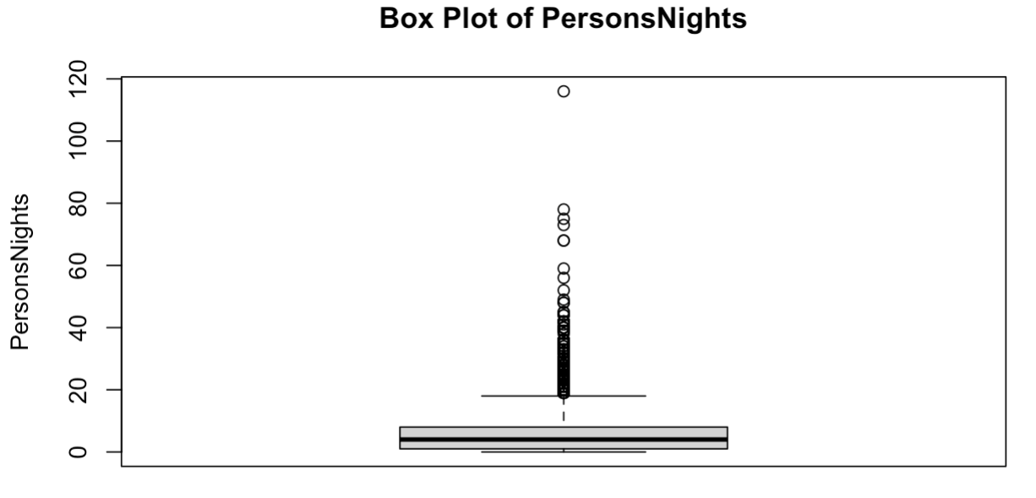
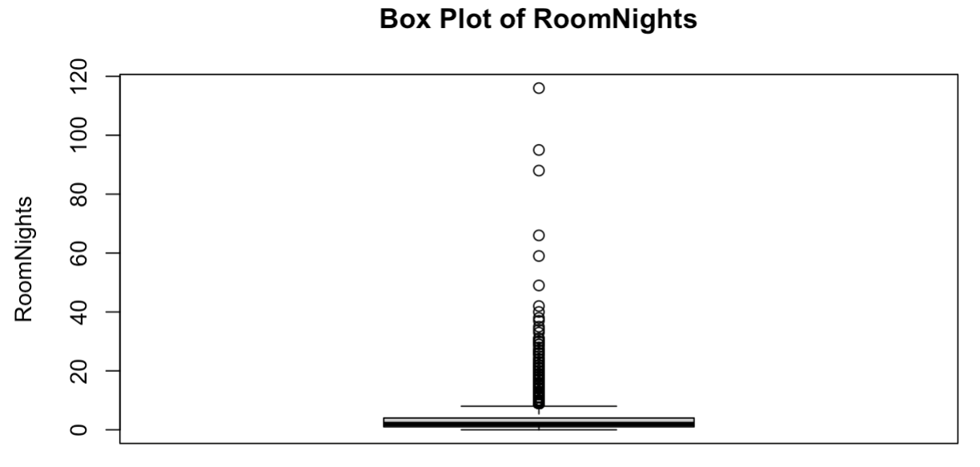
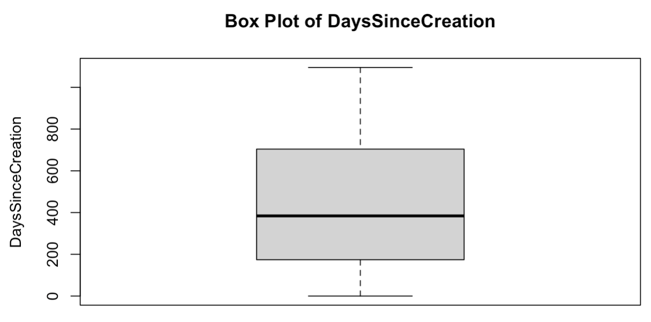
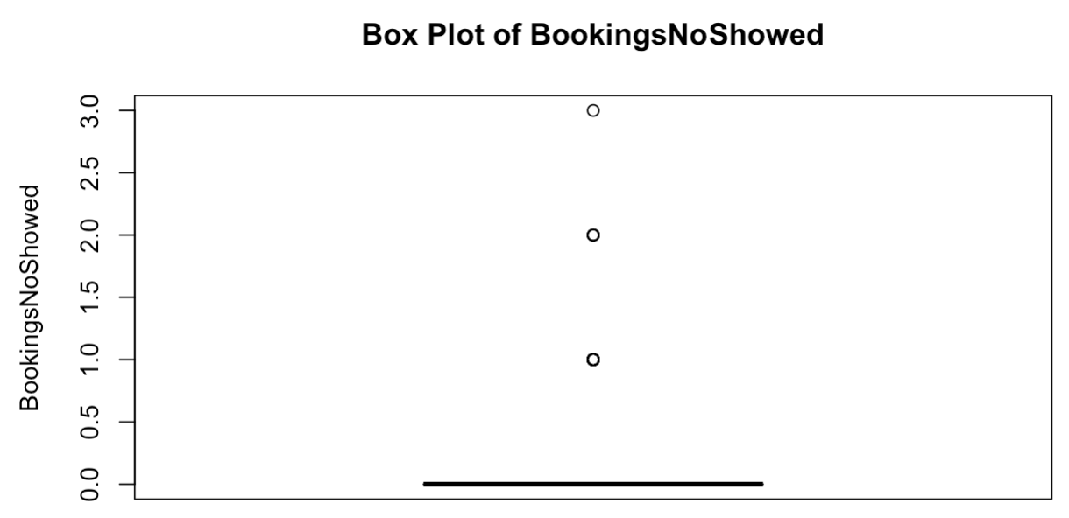
APPENDIX

Slide 21
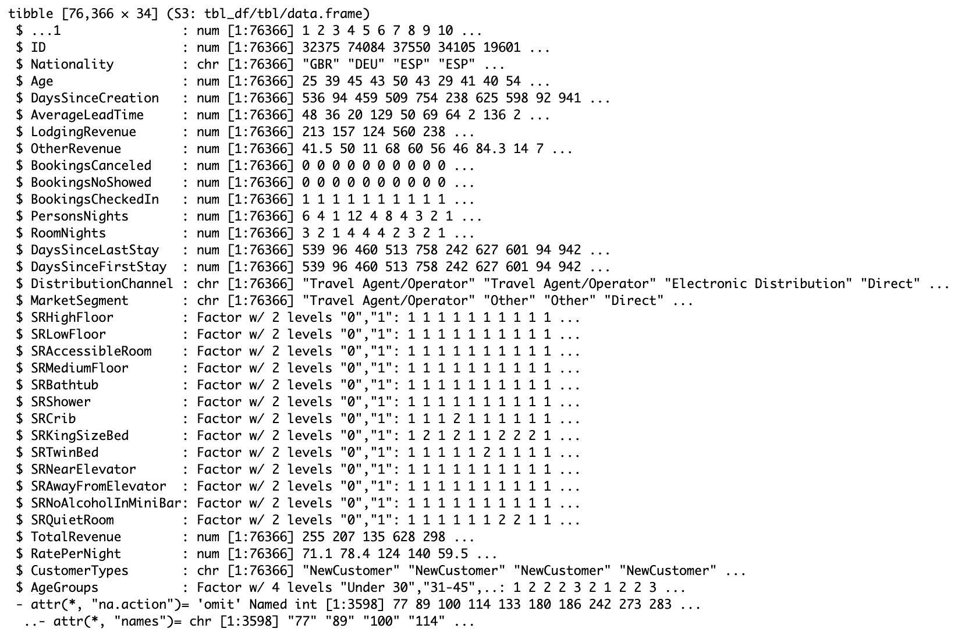
APPENDIX

Slide 22
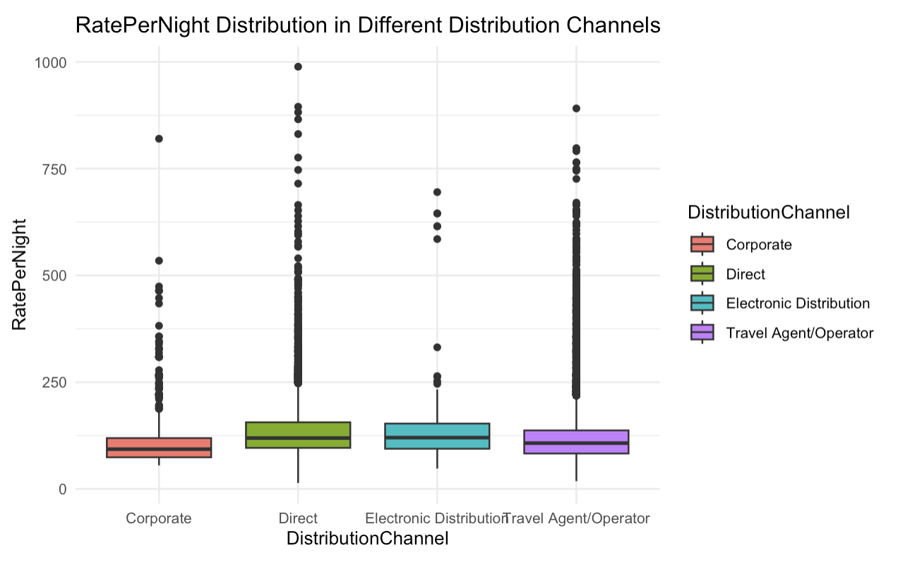
THANK YOU

Slide 23
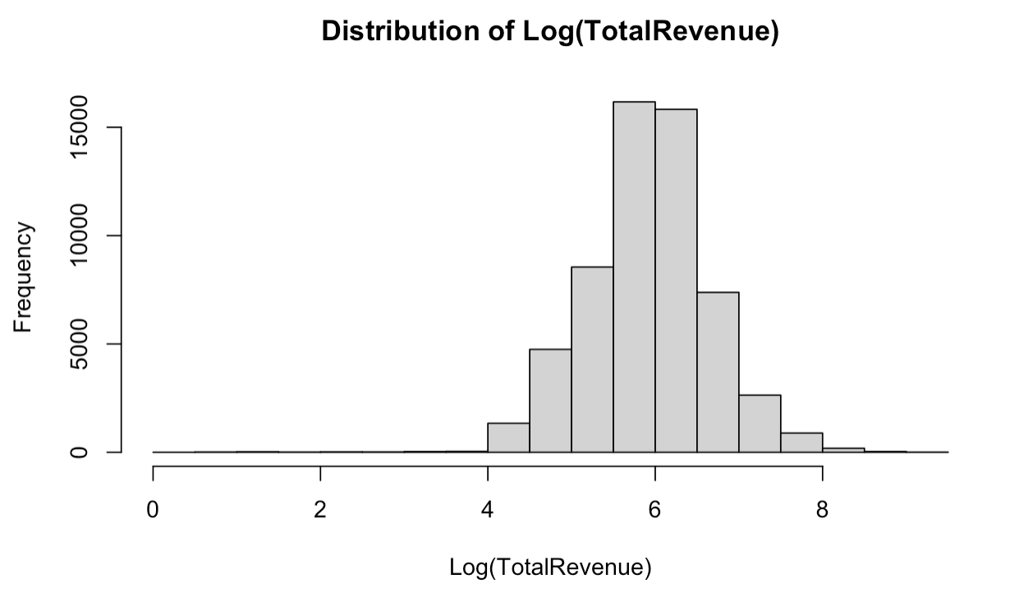
APPENDIX

Slide 24
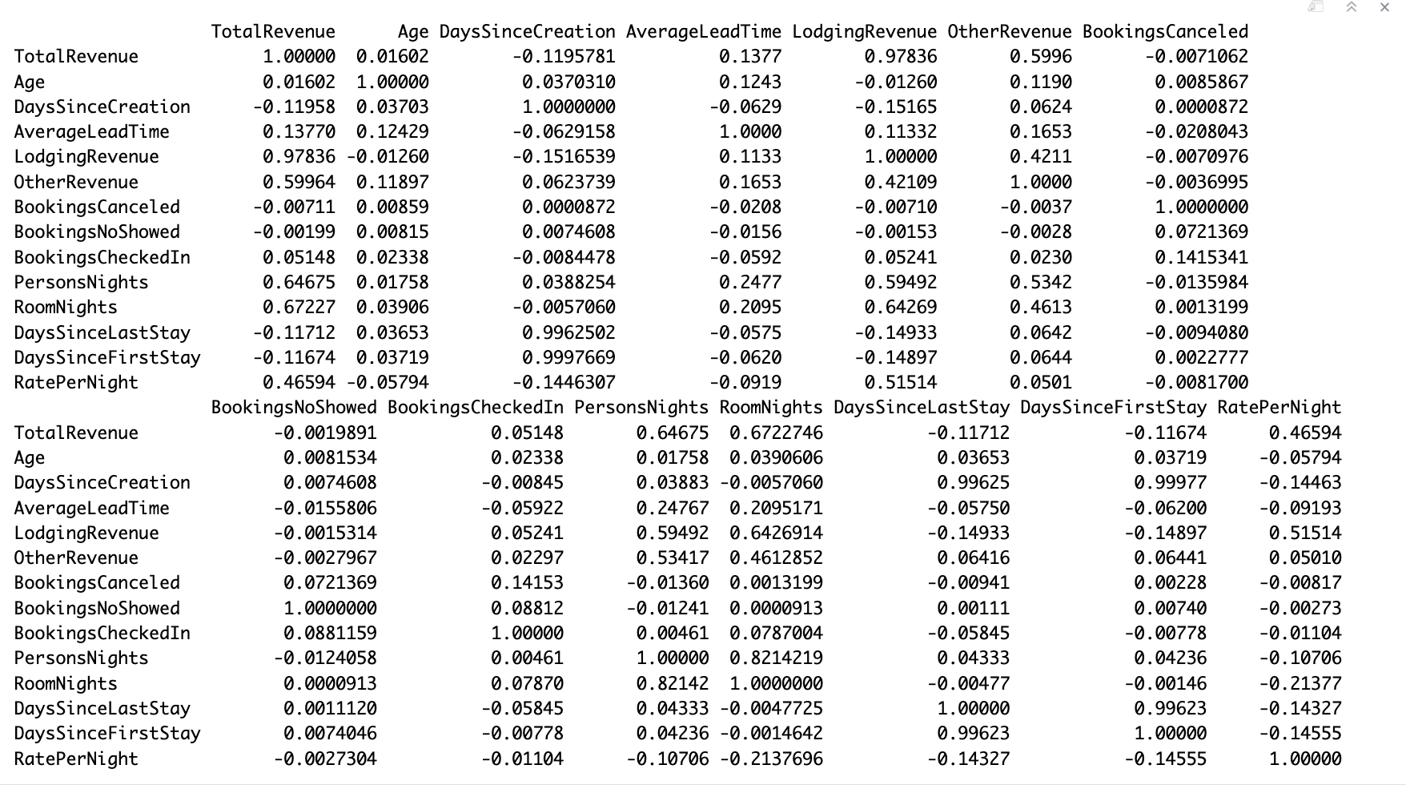
APPENDIX
Correlation Matrix

Slide 25
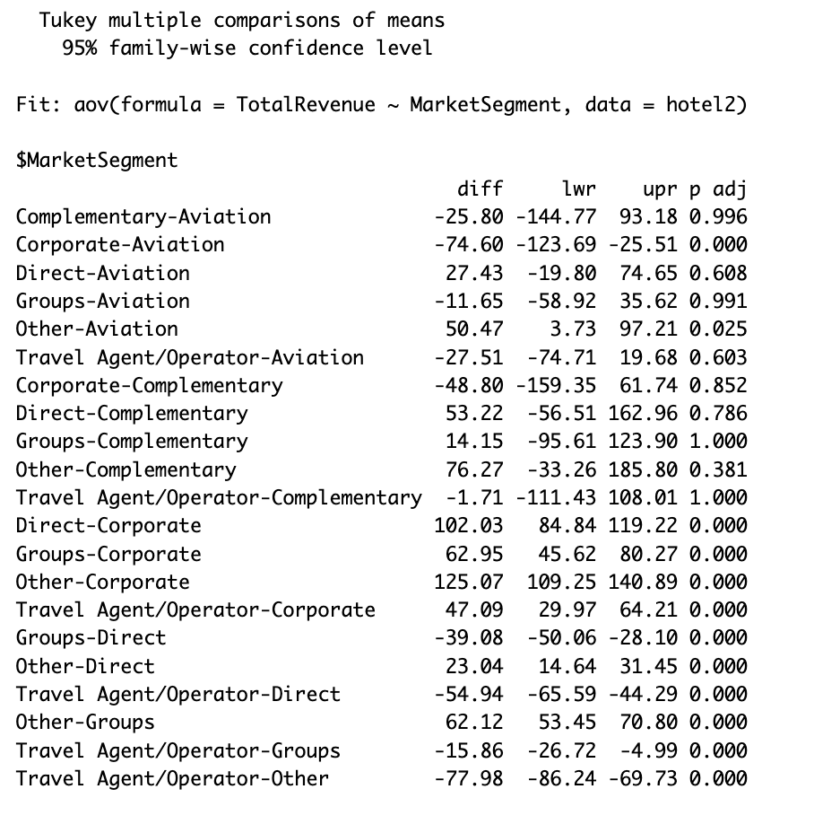
APPENDIX
Test: Grouping Variables

Slide 26
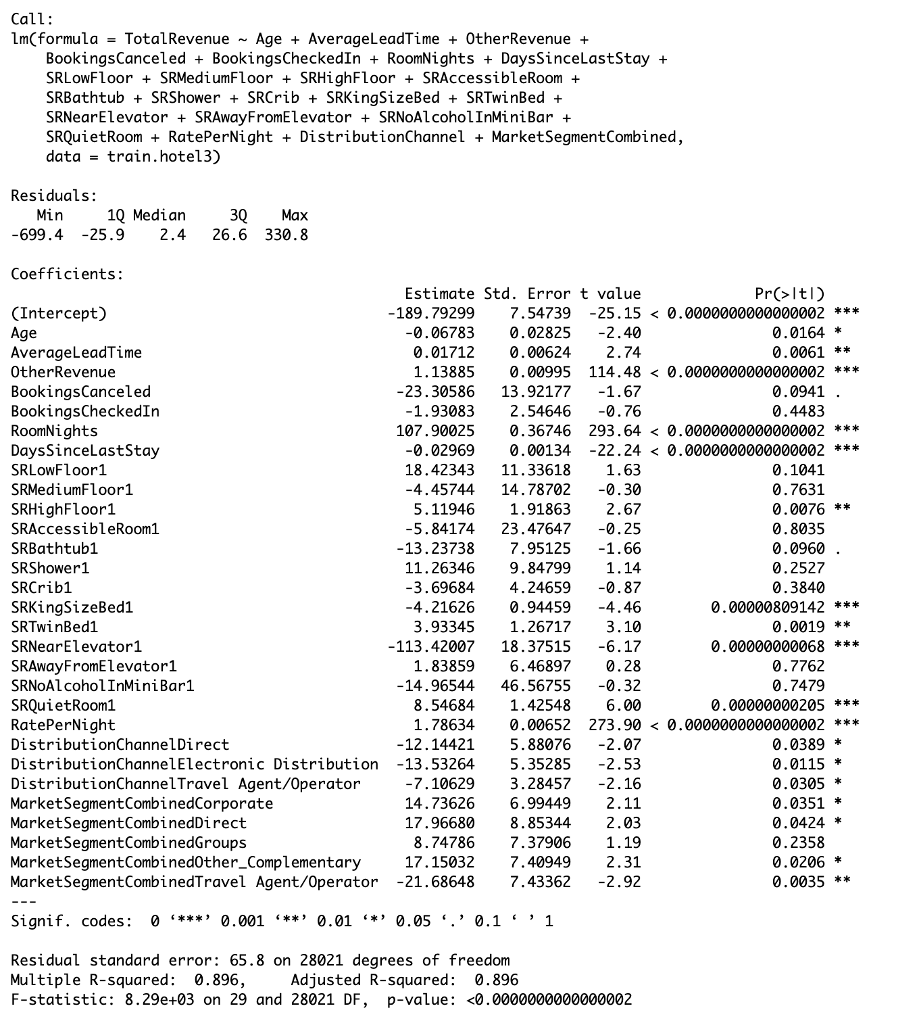
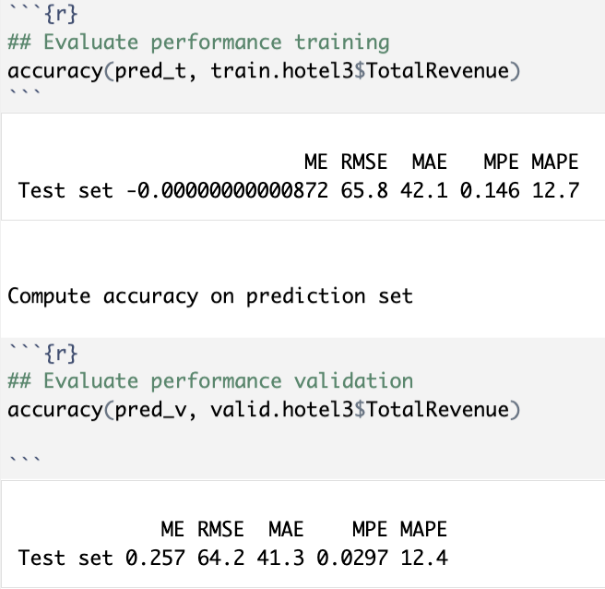
APPENDIX
Multiple Linear Regression

Slide 27
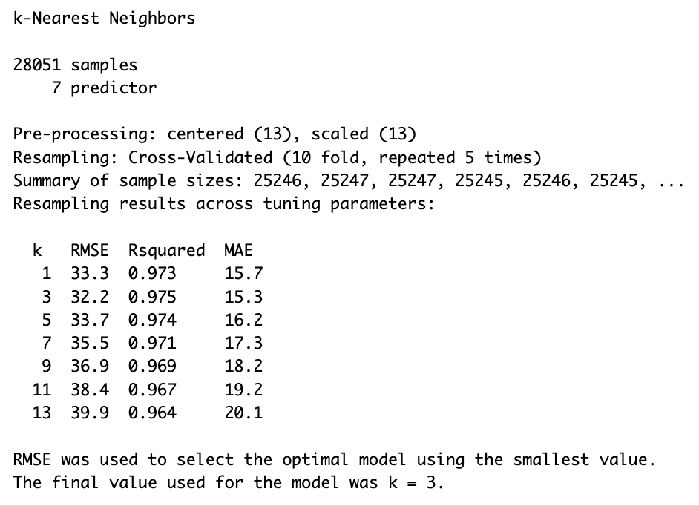
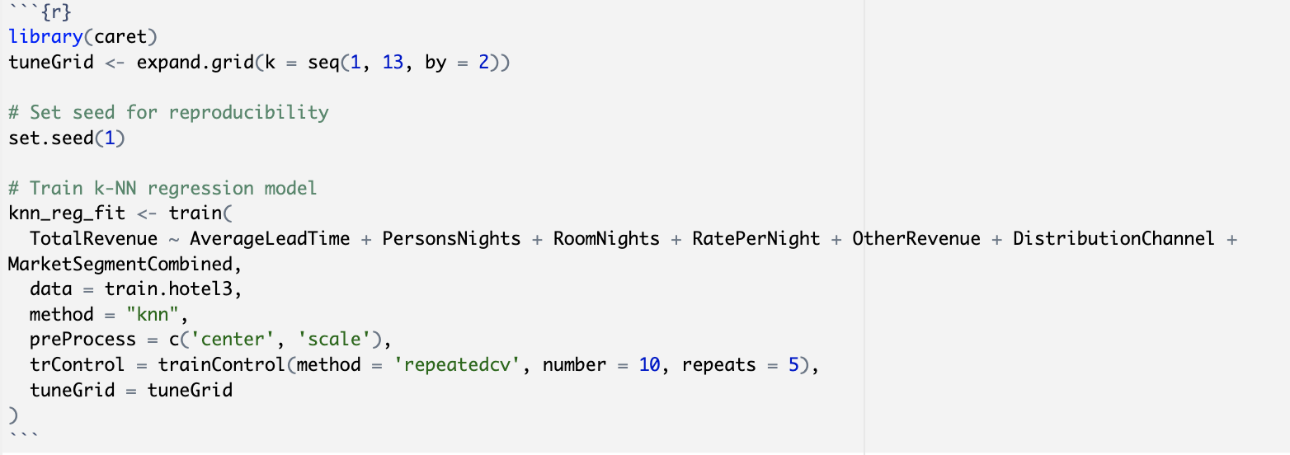
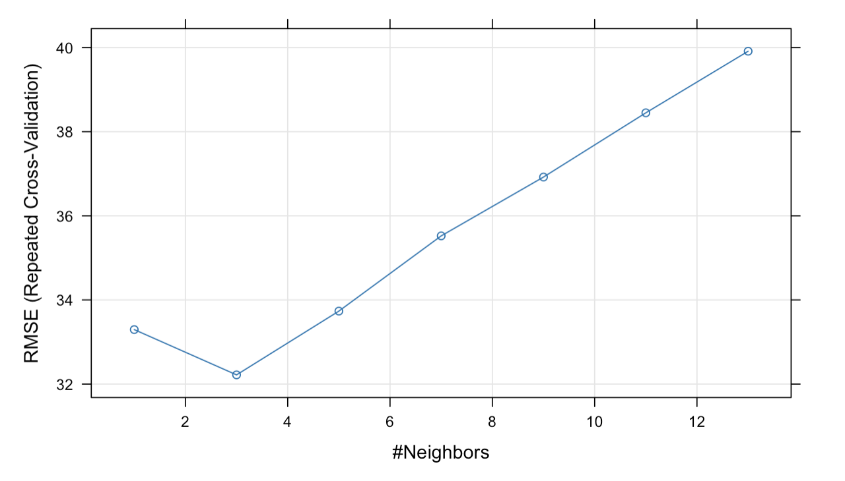
APPENDIX
K-NN Regression

Slide 28
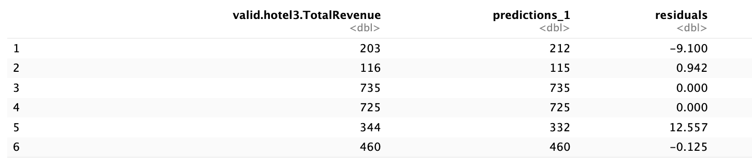
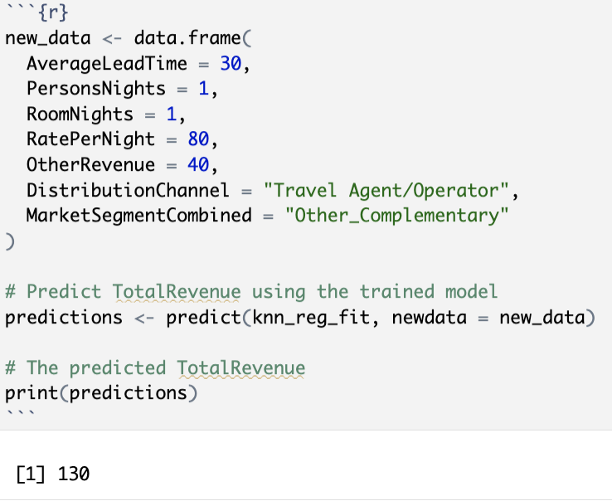
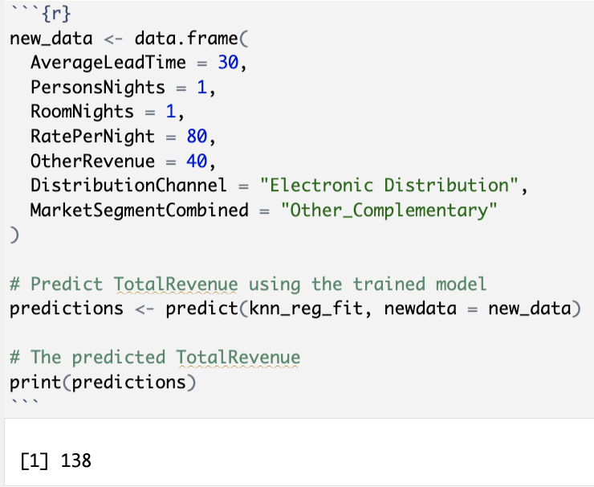
APPENDIX
K-NN Regression
Implement K-NN regression model to predict price

Slide 29
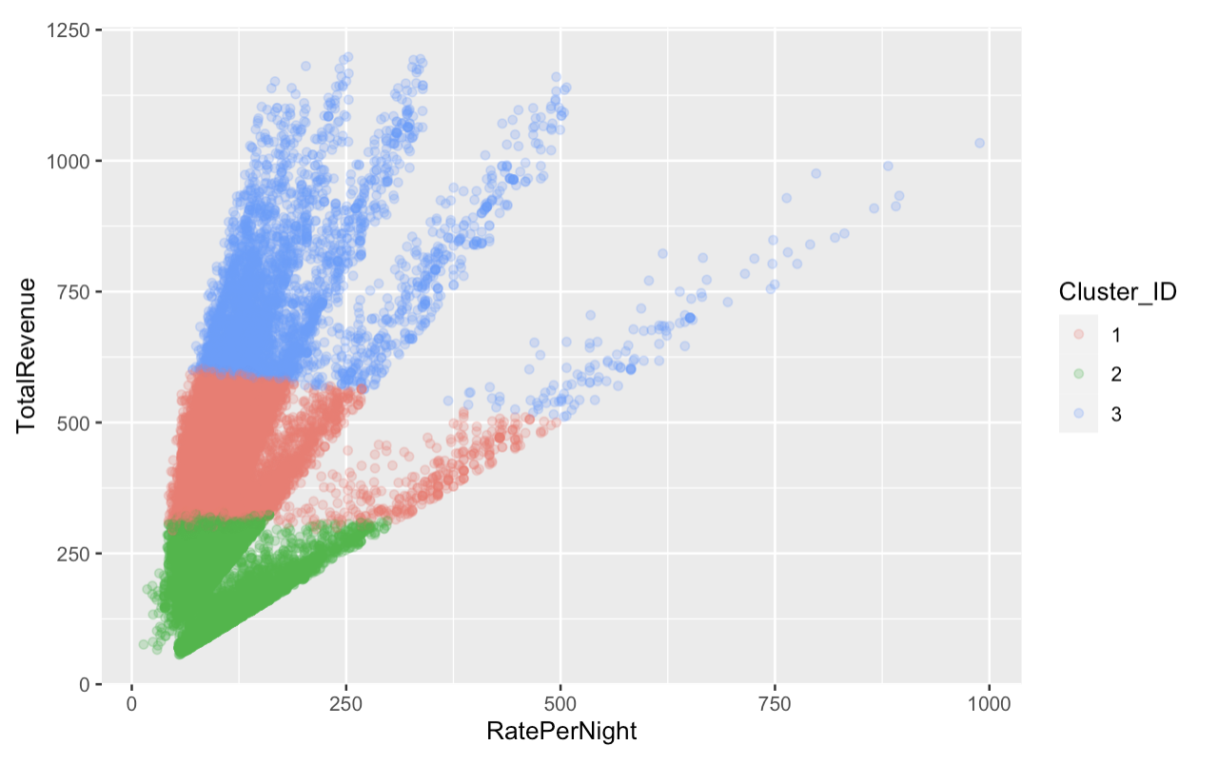
APPENDIX
K-Means Clustering

